Slide 1
Four findings, what alignment means in biology, and the plan
multimodal-bio-fusion · Meeting with Mina Basirat · October 20, 2026
Stage 1 on twelve frozen encoders and two datasets. The Stage 2 definition of alignment for DNA, RNA, and protein. The experimental design, in the research plan's order.
DNA · NT 500M, NT v2, DNABERT-2, HyenaDNA
RNA · RNA-FM, RiNALMo, mRNA-FM, CaLM
Protein · ESM-2 8M, 35M, 150M, ProtBERT
Julian McKinley and Chase Di Maria Breisinger | MSDA AI Track, UCF | Full record: the Overleaf manuscript multimodal-bio-fusion
Notes:
Mina has the Overleaf, so this deck does not walk through every result. It covers the four findings that shape the project, what we think alignment should mean for DNA, RNA, and protein, and the experimental design in the order the research plan sets: reproduce BioLangFusion, change encoders, LucaOne, full transcripts, and the distillation idea to think about. About twenty minutes, then questions.

Slide 2

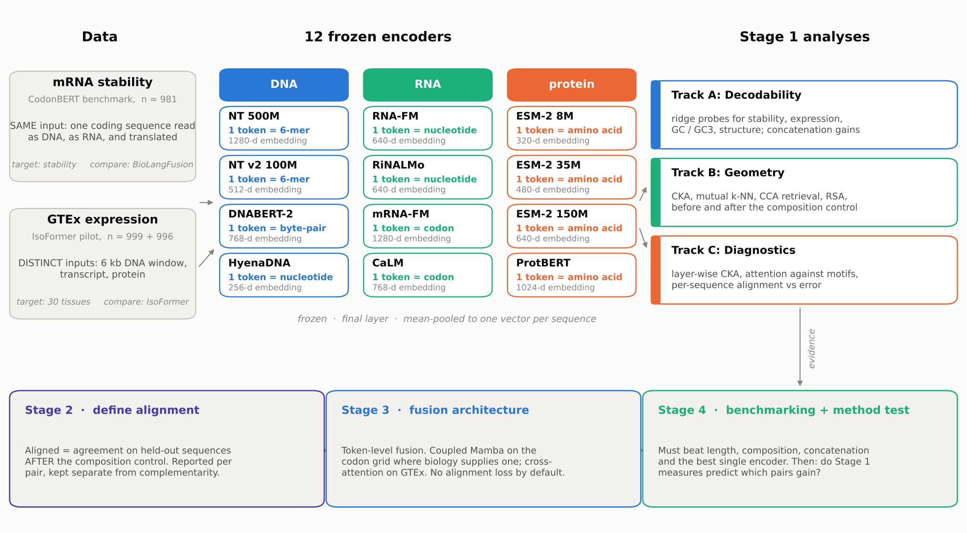
Twelve frozen encoders, two datasets with opposite designs, three tracks
Stage 1 in one slide
On the stability data every encoder reads the same coding sequence; on GTEx each modality is a different molecule. All encoders frozen, final layer, mean-pooled; ridge probes on sequence- or gene-grouped folds.
Notes:
Quick orientation. Four encoders per modality, chosen to vary tokenizer, training corpus, and model family. Two datasets with opposite designs: on the mRNA stability benchmark every encoder reads one coding sequence, so differences between encoders are differences between models, not between molecules; on IsoFormer's GTEx data the DNA window, the transcript, and the protein are physically different molecules. Three tracks: what a linear probe can read, how the embedding spaces relate, and diagnostics. Everything else today is built on those twelve encoders and two datasets.

Slide 3

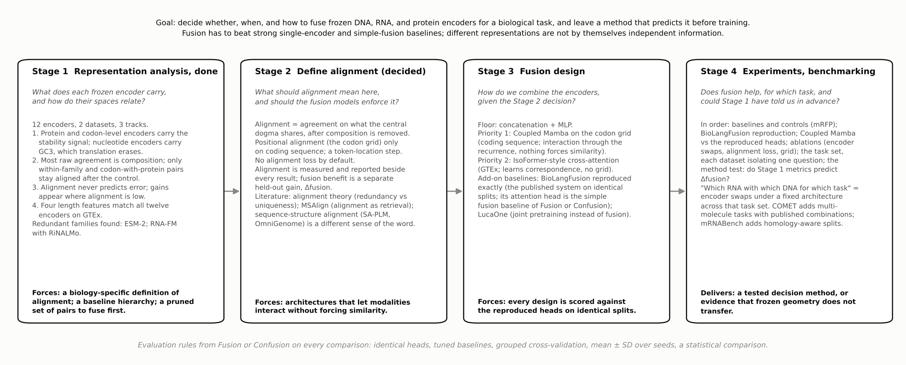
Each stage asks one question, and what it finds forces the next
The project in one chain
Goal: decide whether, when, and how to fuse frozen encoders for a biological task, and leave a method that predicts it before training. The burden of proof is on fusion.
Notes:
Before the findings, the whole project on one slide, because every later slide is a step in this chain. Stage 1 asked what each frozen encoder carries and how the twelve spaces relate; its four findings force Stage 2, a biology-specific definition of alignment, because the usual ML meaning would mislead. Stage 2's decision, no alignment loss and a grid only on coding sequence, forces Stage 3's designs: architectures that let modalities interact without forcing similarity, scored against the published system reproduced exactly. Stage 4 tests whether fusion helps, for which task, and whether Stage 1 could have told us in advance. Mina's research plan and the October papers are placed in this chain rather than beside it: the reproduction and LucaOne are the baselines in Stage 3, the encoder swaps and the new tasks are Stage 4, and Fusion or Confusion gives the evaluation rules on every comparison.

Slide 4

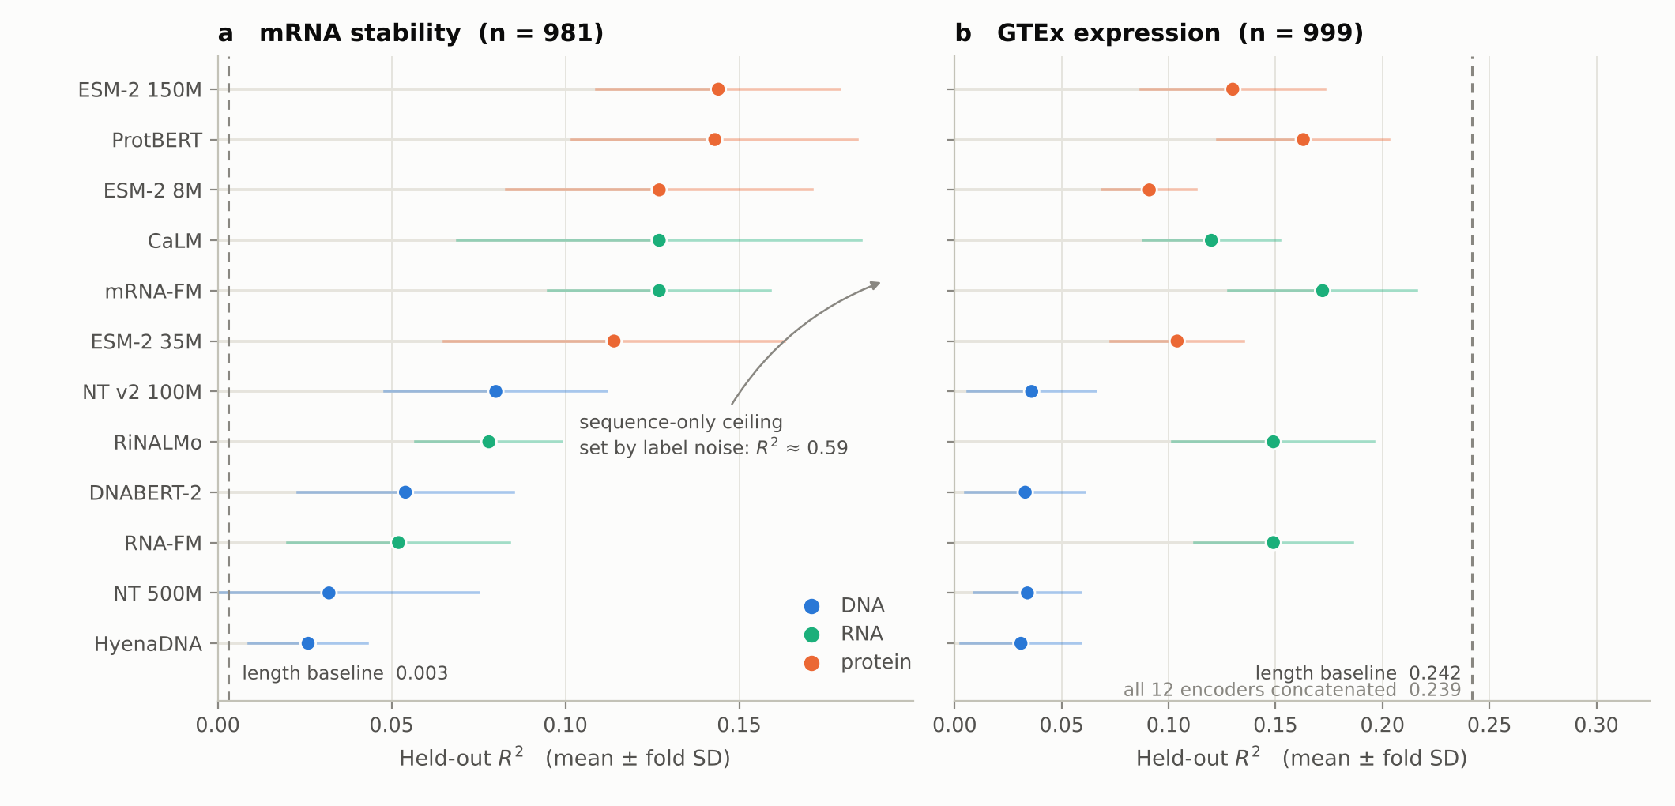
Protein and codon-level encoders carry the stability signal; translation erases codon choice
Finding 1 · where the signal is
0.11 to 0.14
Stability R² for the protein encoders and both codon-level encoders; the other nucleotide encoders reach 0.03 to 0.08. Length alone: 0.003.
0.26 to 0.30
R² lost from GC to GC3 by the protein encoders: translation discards synonymous codon choice, which every nucleotide encoder keeps (GC3 0.90 to 0.99).
Label noise caps any sequence-only model near R² 0.59 on this file, so 0.14 is about a quarter of what is reachable. On GTEx, four transcript-length features (0.242) beat every single encoder.
Notes:
The protein encoders and the two codon-level RNA encoders, mRNA-FM and CaLM, carry the most linearly readable stability signal, about 11 to 14 percent of the variance. That result does not depend on one model: two codon encoders from different groups land in the protein range. The second number is the one I want to highlight for alignment later: when we probe for GC3, the GC fraction at the third codon position, the protein encoders lose 0.26 to 0.30 of R squared while the nucleotide encoders lose almost nothing. Translation erases synonymous codon choice, and that is information the nucleotide side has that the protein side cannot. Remember the ceiling: repeated sequences carry labels that differ by about 0.49, so no sequence-only model can go above about 0.59 on this file.

Slide 5

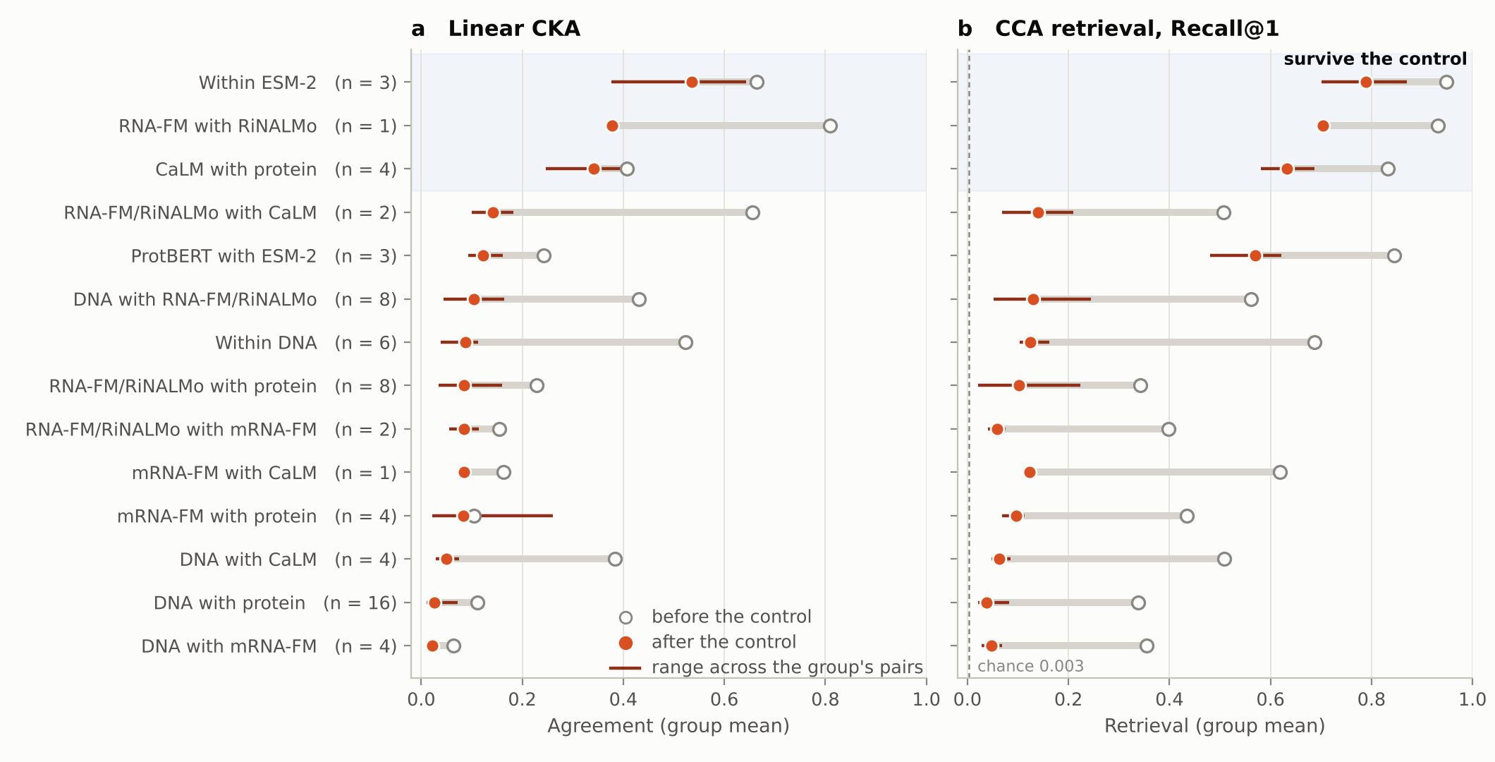
Most cross-encoder agreement is sequence composition, and the pairs that survive are the ones biology predicts
Finding 2 · how the encoders relate
52% to 90%
Drop in CKA for every pair with a DNA encoder once 87 composition features (GC, GC3, length, codon and amino-acid frequencies) are regressed out.
58% to 69%
CaLM still finds its protein partner after the control, about 170 to 200 times chance. The ESM-2 models and RNA-FM with RiNALMo also keep theirs; little else does.
Agreement follows tokenizer and training more than the modality label: RNA-FM with RiNALMo CKA 0.809, the two codon encoders with each other only 0.163.
Notes:
Every one of the 66 encoder pairs agrees above chance, and every pair shares a strong low-dimensional subspace. But when we regress 87 composition features out of each embedding and recompute agreement, every pair involving a DNA encoder loses 52 to 90 percent of its CKA. That agreement was letter counts, which any model could learn. Three groups keep their agreement: the ESM-2 models with each other, RNA-FM with RiNALMo, and CaLM with the protein encoders. Those are two models of one molecule, and a codon encoder with the protein encoders, which share the coding sequence and its translation by construction. That is the first hint that alignment in biology should be defined on what the central dogma shares.

Slide 6

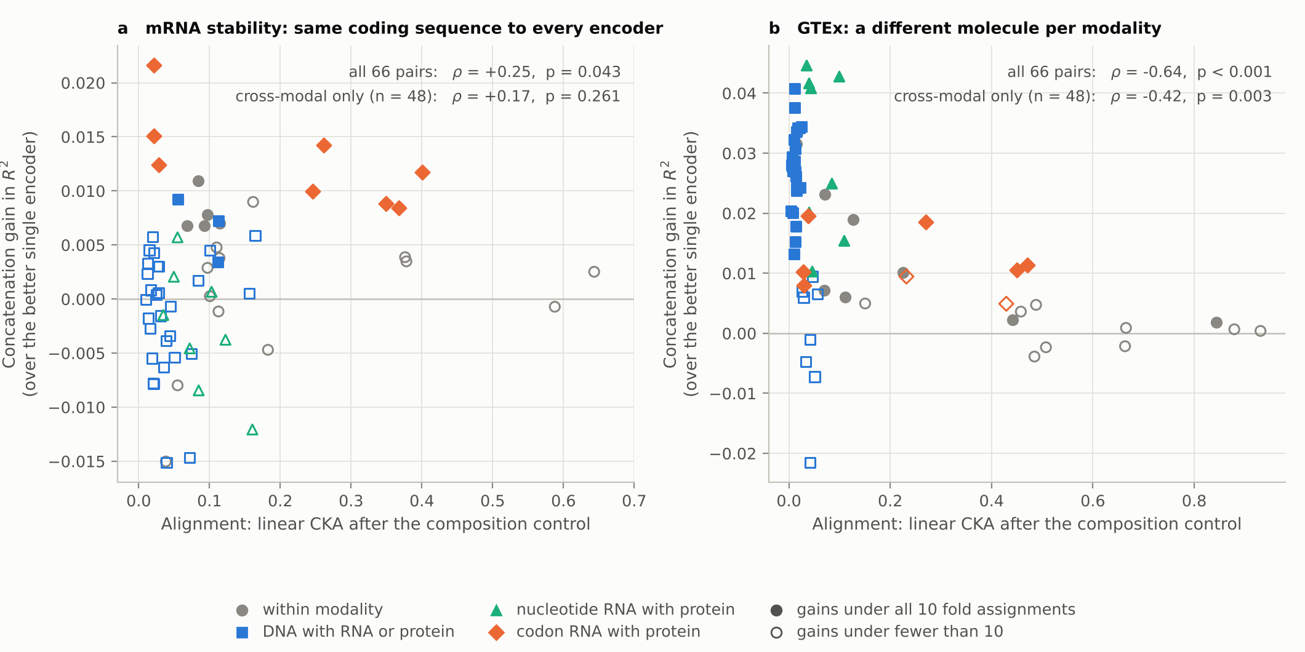
Alignment does not predict where combining encoders helps, on either dataset
Finding 3 · alignment against complementarity
8 of 8
Codon-level RNA with protein pairs gain under every fold assignment on stability, whether aligned (CaLM) or not (mRNA-FM). Larger concatenations add nothing.
0 of 66
Pairs on either dataset where a sequence's alignment across two encoders tracks its prediction error after correction (Spearman between -0.13 and +0.12).
Across the 48 cross-modal pairs: Spearman +0.17 (p = 0.26) between alignment and gain on stability, and -0.42 (p = 0.003) on GTEx, where the least aligned pairs gain most.
Notes:
This is the slide that decides the Stage 2 question. On the x axis, alignment after the composition control; on the y axis, how much a pair gains when concatenated over its better member. On the stability data there is no usable relation: mRNA-FM, which agrees with almost nothing, gains with every protein encoder, and so does CaLM, the most aligned cross-modal encoder. On GTEx the relation is negative: the pairs that gain most are the least aligned. And at the level of individual sequences, how well a gene's two embeddings line up has no relation to how well it is predicted, for any of the 66 pairs. That is exactly the regime the alignment-theory paper describes, where task-relevant information is unique to one modality and alignment stops predicting performance.

Slide 7

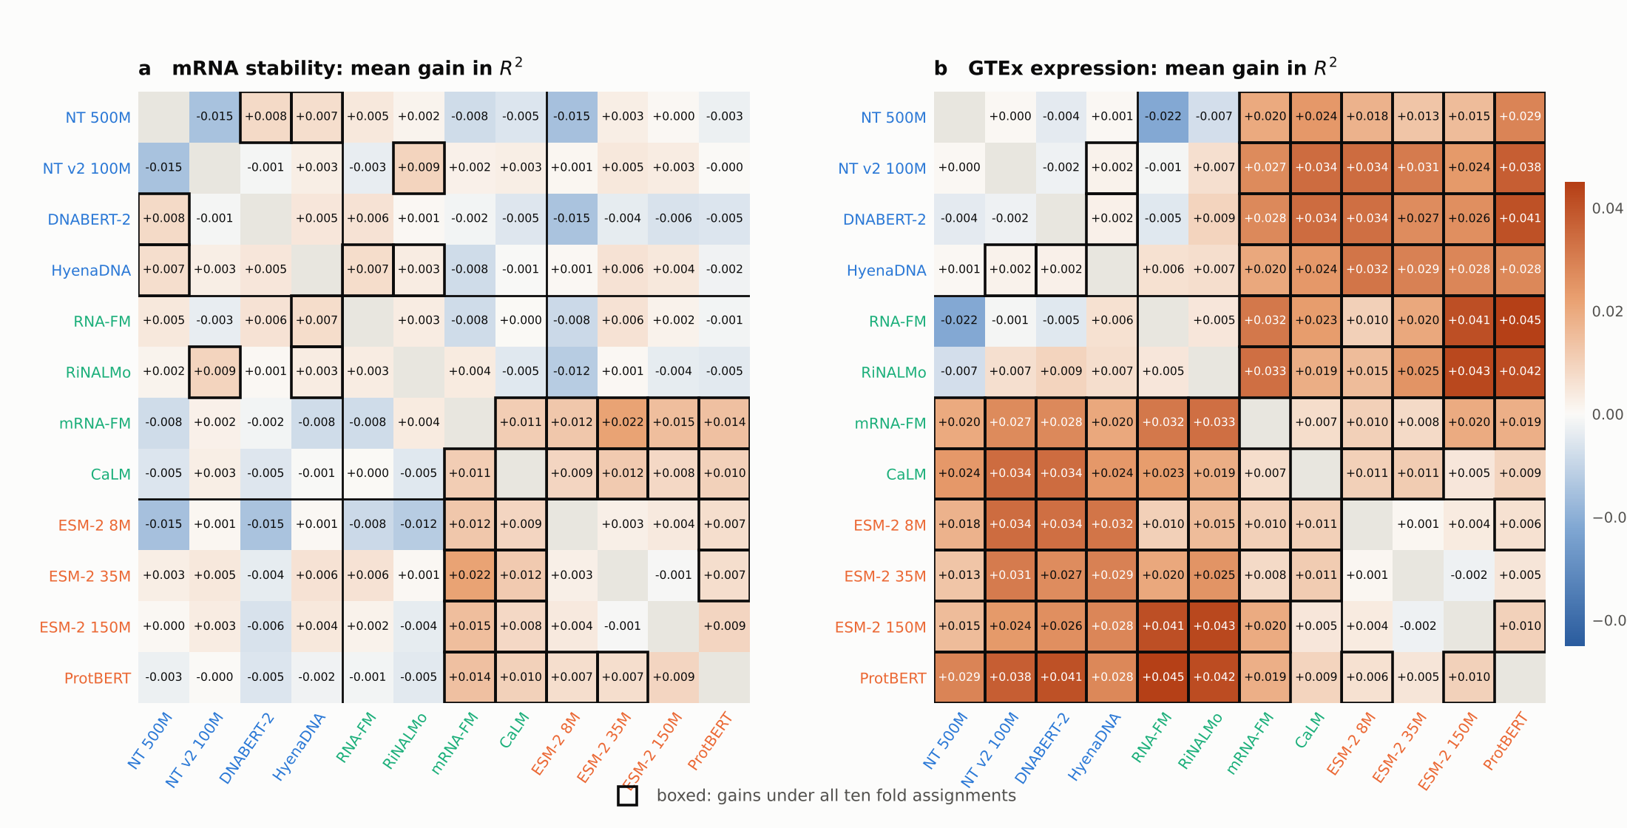
With different molecules, DNA adds signal it cannot be aligned to, and four length features match all twelve encoders
Finding 4 · distinct molecules
16 of 16
DNA with protein pairs gain on GTEx under every fold assignment, although the DNA window retrieves its own protein at most 1.6% of the time.
0.242 vs 0.239
Four transcript-length features against all twelve encoders concatenated. On GTEx the bar a fusion model must clear is length, not zero.
Boxed cells gain under all ten fold assignments: 16 pairs on stability, 47 on GTEx. The window adds information precisely because it does not repeat what the other encoders read.
Notes:
Same analysis, both datasets side by side. On stability, where every encoder reads one coding sequence, the consistent gains sit in one block, codon-level RNA with protein. On GTEx, where the DNA window, the transcript, and the protein are different molecules, nearly every cross-modal pair gains, and every DNA encoder gains with every protein encoder even though the window and the protein have almost no retrievable correspondence. That is the uniqueness case: the window adds signal because it carries information the other molecules do not have. The sobering number is the length baseline. Transcript, coding-sequence, and UTR lengths alone reach 0.242, which is what all twelve encoders reach together, so any GTEx result has to be read against length.

Slide 8
Alignment is agreement on what the central dogma shares, beyond composition, with nothing imposed on what it does not share.
Stage 2 · what alignment means in biology
Why we have to say it
What it changes
No published work defines alignment for DNA, RNA, and protein representations or measures it. BioLangFusion assumes it (a codon grid), IsoFormer learns it unnamed (cross-attention), the Central Dogma Transformer orders it; the general theory is not biology-specific.
Positional alignment is given by the genetic code and only on coding sequence; resampling to the codon grid is a token-location step, not evidence of shared information. Representational alignment is measured after the composition control and reported next to every fusion result; it is not a training loss and not a prerequisite. Whether fusion helps is settled by a held-out gain over the best single encoder.
Notes:
This is the definition we are proposing, and the reason we spend a section on it. In machine learning, alignment means two views of one thing are trained to coincide. For DNA, RNA, and protein that is the wrong picture, and as far as we can find nobody has written down what the right one is for sequence encoders. Our definition: alignment is agreement on what the central dogma shares, measured after composition is removed, and not imposed on the parts each molecule has alone. The next slide shows why the biology forces that.

Slide 9
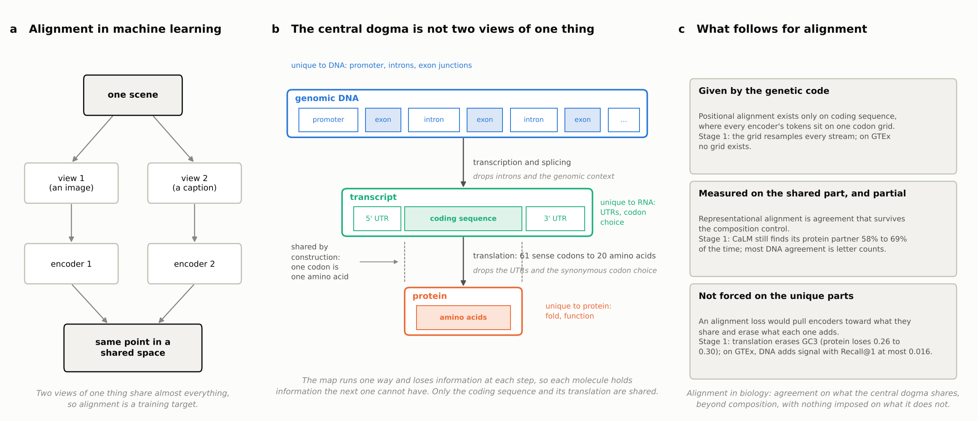
The central dogma is not two views of one thing
Why the usual meaning does not transfer
Redundancy by construction: the coding sequence determines the protein. Uniqueness by construction: 61 codons to 20 amino acids. Unique context at every level: genome, UTRs, fold. Each one was measured in Stage 1.
Notes:
Left: the machine-learning picture, two views of one scene, representations trained to coincide, which works because the views share almost everything. Middle: the biology. Each molecule is made from the previous one by a map that runs one way and loses information at each step. Three consequences, each of which we measured. Redundancy by construction: the coding sequence determines the protein, so that is the part they share, and it is where CaLM and the protein encoders stay aligned after the control. Uniqueness by construction: 61 sense codons encode 20 amino acids, so the coding sequence holds the synonymous codon choice that translation erases, which is the GC3 result and why codon encoders complement protein encoders. Unique context at every level: promoters, introns, UTRs, the protein fold; nothing to align those to, which is why on GTEx the DNA window adds signal with no retrievable correspondence. Right: what follows. Positional alignment is given by the genetic code and only on coding sequence. Representational alignment is measured on the shared part, after composition, and is partial. And nothing is imposed on the unique parts, because an alignment loss would erase exactly what fusion is meant to combine.

Slide 10
Four rungs, each stricter; our definition sits at the third
How representational alignment is measured
Rung and measure | The question, in biological terms | What Stage 1 found
1. Raw similarity: linear CKA, mutual k-NN, RSA | Do the two encoders call the same genes similar? | Follows tokenizer and training corpus, not the modality label; every pair above chance.
2. Shared directions: CCA, Recall@1 | Is there any view in which one encoder's embedding of a gene finds the other's? | Yes for every pair (first canonical correlation 0.90 to 0.99): a learnable mapping always exists.
3. After the composition control | Is the agreement more than letter, codon, and amino-acid counts, which any model could learn from the sequence alone? | For pairs with a DNA encoder, mostly not. The protein encoders, RNA-FM with RiNALMo, and CaLM with protein keep most of theirs.
4. Against prediction: concatenation gain, alignment-error association | Does agreeing help, and do better-aligned genes get better predictions? | Complementarity is largest where alignment is low; per-sequence alignment never tracks error.
A pair can pass rung 1 and fail rung 3, which is what every pair with a DNA encoder does on the stability data. Rung 4 is why alignment is reported beside every fusion result rather than trained for.
Notes:
Alignment is not one number. The measures ask different questions and the questions get stricter. Rung one: do two encoders call the same genes similar; CKA, nearest neighbors, RSA. Rung two: is there any view in which one encoder can find the other's embedding of a gene; CCA and retrieval, and the answer is yes for every pair. Rung three: is the agreement more than counts; this is where most DNA agreement disappears, and it is where our definition sits. Rung four: does agreeing help prediction; it does not, and that is why alignment is something we report beside every fusion result rather than a loss we train toward. If we had read a single CKA value as alignment, the DNA pairs would have looked among the most aligned; the ladder puts them among the least.

Slide 11
Stage 3 builds the fusion models; Stage 4 tests whether they help
Experimental design · overview
Stage 3 · fusion architecture design
Stage 4 · experimental design and benchmarking
How do we combine the encoders?
Does fusion beat the best single encoder, and could Stage 1 predict it?
Floor: concatenation + MLP, which every model must beat
Priority 1: Coupled Mamba on the codon grid (coding sequence)
Priority 2: IsoFormer-style cross-attention (GTEx, no grid)
Added baselines: BioLangFusion reproduced exactly; LucaOne
Hypotheses H1 to H6 and baselines B0 to B5
Datasets and tests chosen so each isolates one question
Ablations: alignment loss, codon grid, modality dropping
Method test: do Stage 1 metrics predict the fusion gain?
Added: encoder swaps, mRNABench tasks, mRFP control, distillation
Frozen encoders, no alignment loss by default, positional alignment only where the genetic code gives it.
Notes:
Before the design slides, the two stages in one picture. Stage 3 is the build: which fusion architectures we train. Concatenation plus an MLP is the floor; Coupled Mamba is our first choice on coding sequence and cross-attention second, for GTEx where there is no shared grid. Mina's research plan adds two baselines here, a faithful reproduction of BioLangFusion and LucaOne, which is jointly pretrained. Stage 4 is the test: the hypotheses, the baselines every result has to clear, the datasets, the ablations, and the method test, which asks whether the cheap Stage 1 measurements predict where fusion helps. Most of the research plan's add-ons land in Stage 4. The next slide is Stage 3; everything after it is Stage 4.

Slide 12
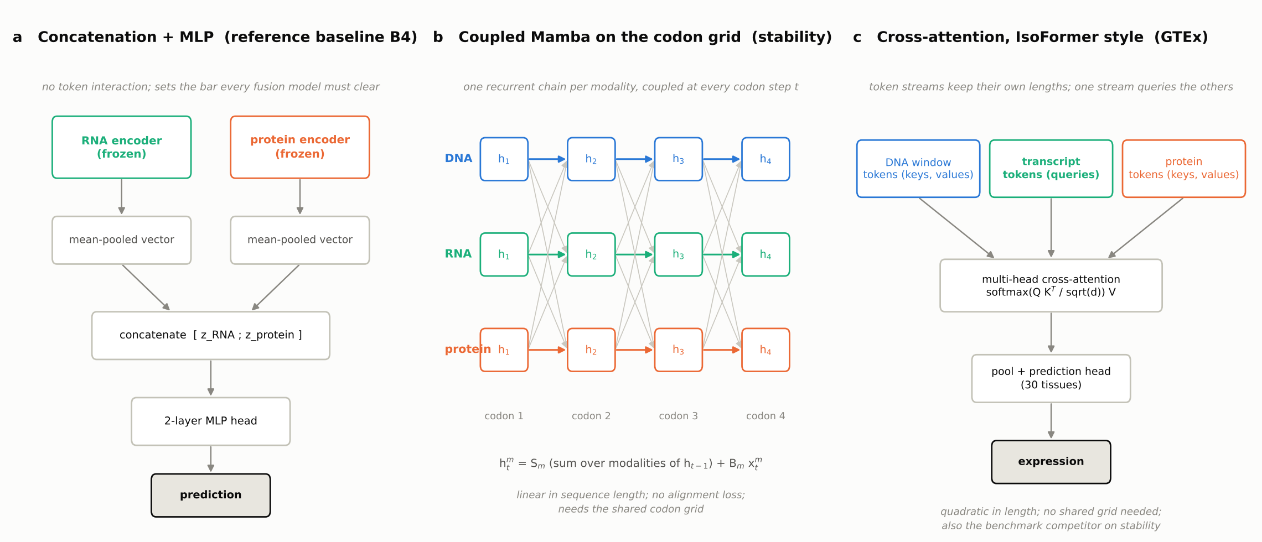
Three fusion designs, and the decision they follow
Stage 3 · fusion architecture design
Positional alignment only where biology gives it: the codon grid on coding sequence, cross-attention or pooled fusion on GTEx.
No alignment loss by default; one paired ablation on CaLM and on mRNA-FM with the same protein encoder.
Coupled Mamba first (Gantt 20 to 21), cross-attention second (25); both scored against the reproduced BioLangFusion heads on identical splits.
Notes:
Stage 3 is unchanged: it turns the Stage 2 decision into trainable modules over token-level embeddings. Concatenation plus an MLP is the reference every fusion model must beat. Coupled Mamba is the priority architecture on coding sequence, agreed in September: one recurrent chain per modality, coupled at every codon step, so the modalities exchange information without any term that makes them look alike, linear in sequence length. IsoFormer-style cross-attention is second, for GTEx where there is no grid, and the benchmark competitor on stability. What the research plan adds is the baseline these are scored against. From the next slide on, we are in Stage 4: how all of this gets tested.

Slide 13
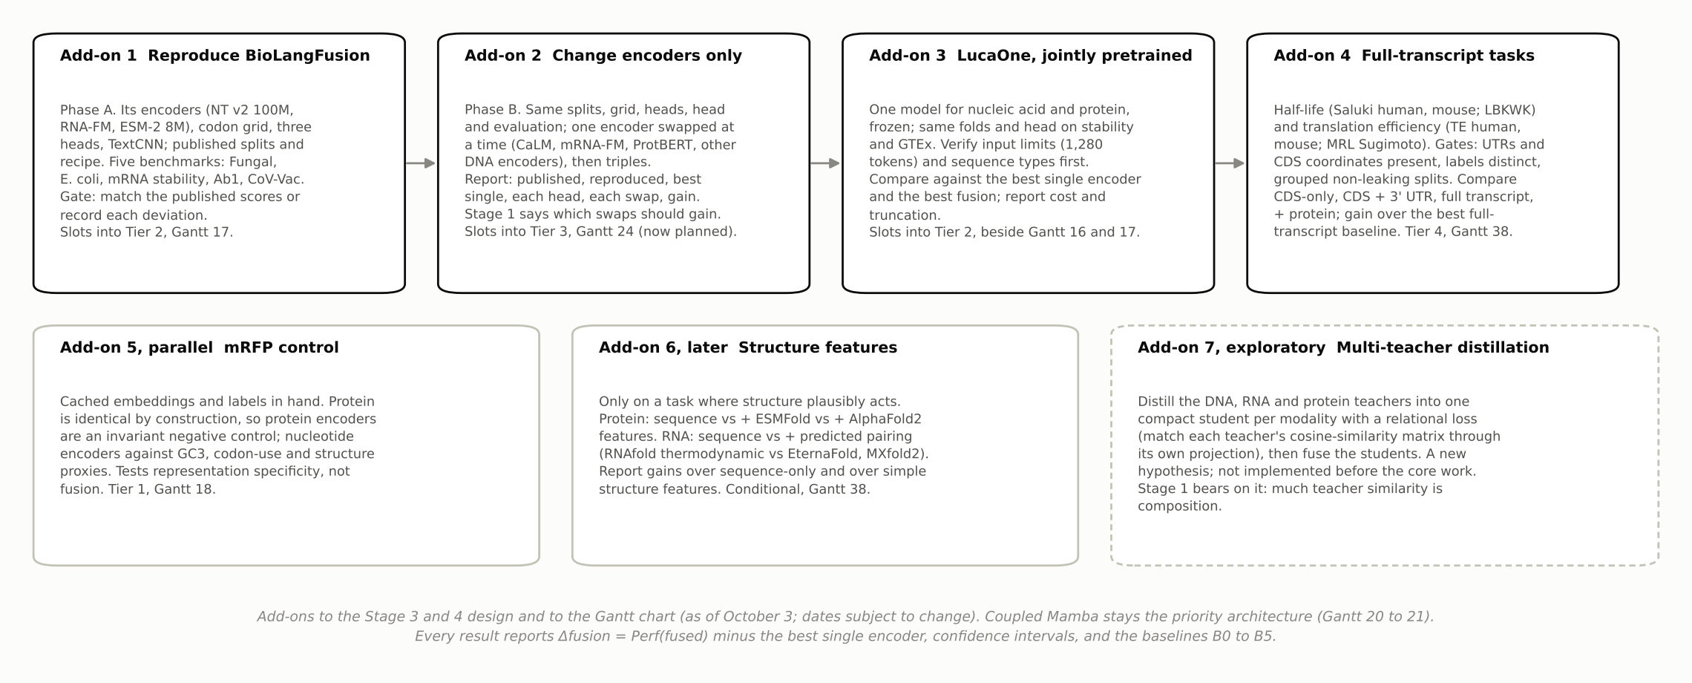
Seven add-ons to the Stage 4 design, each with a place in the tiers and the Gantt chart
Stage 4 · what the research plan adds
Nothing planned is replaced: Coupled Mamba stays the priority architecture, the tiers and ablations stand, the task set keeps its order. Each add-on sharpens one thing: a matched published baseline, the cleanest test of H2, a joint-pretraining comparison, precise label gates.
Notes:
These are the items from the research plan, shown as add-ons to the design on the previous slide. Add-on one widens the matched BioLangFusion comparison already in the Gantt chart, ID 17, to a faithful reproduction on all five of its published datasets, and that reproduction becomes the matched baseline Coupled Mamba is scored against. Add-on two turns the conditional encoder comparison, ID 24, into a planned one. Add-on three is LucaOne as a jointly pretrained baseline, a new row. Add-on four is half-life and translation efficiency on the mRNABench splits, which sits in the January to February extension slot unless cluster time allows earlier. Add-on five, the mRFP control, is already in the controls of ID 18. Structure features are conditional. The distillation idea is to think about, not build; we have thoughts on it near the end. Dates are as of October 3 and will move.

Slide 14
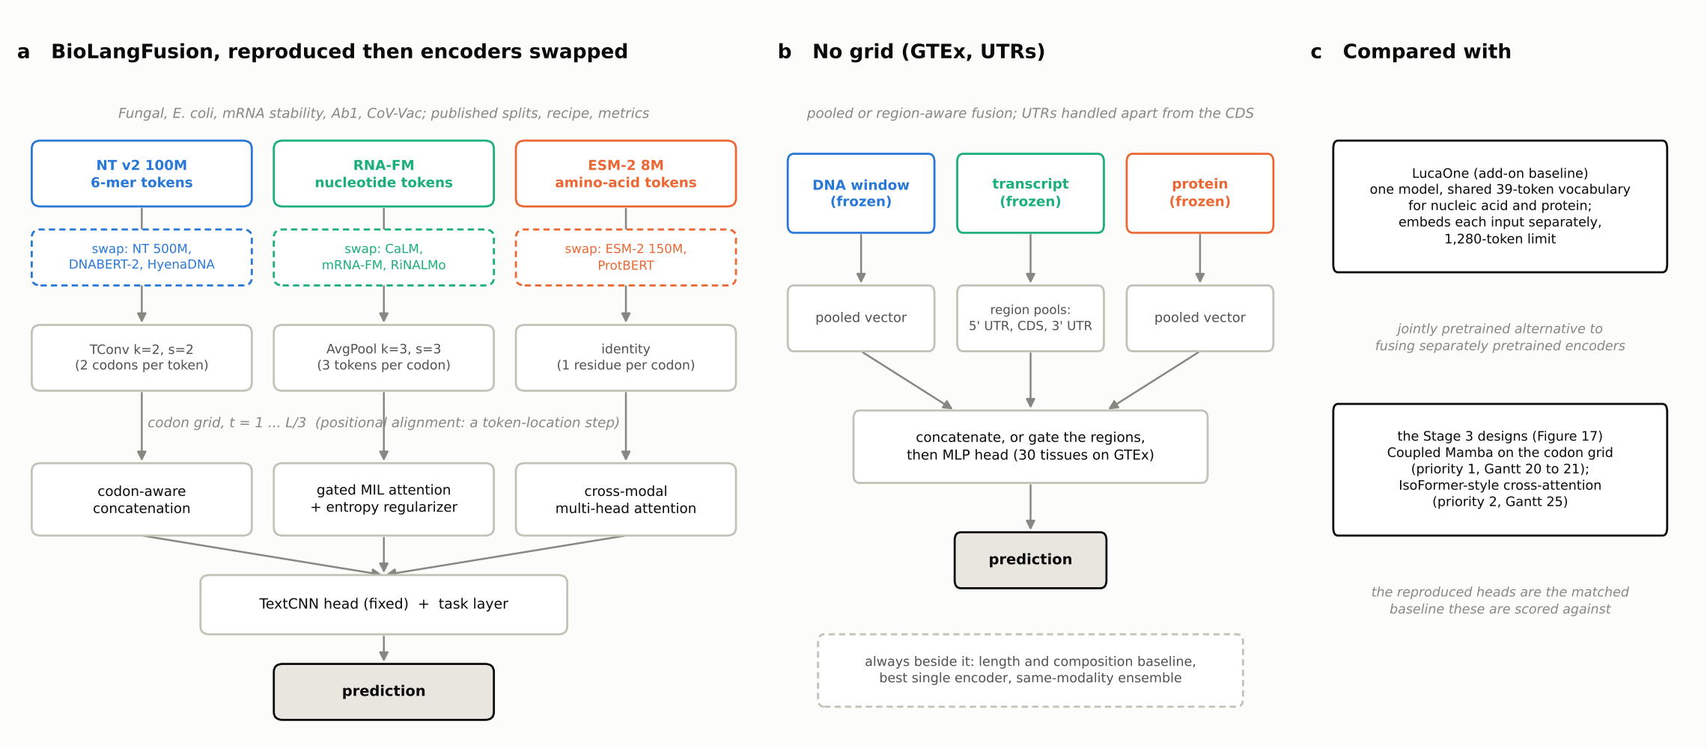
Reproduce BioLangFusion exactly, then change the encoders and nothing else
Stages 3 and 4 · added baseline, add-ons 1 and 2
Phase A, fixed: NT v2 100M, RNA-FM, ESM-2 8M on the codon grid; the three heads; one TextCNN head; the CodonBERT splits and recipe; every unreported detail recorded as a deviation.
Phase B, swapped one at a time: CaLM or mRNA-FM for RNA-FM; ESM-2 150M or ProtBERT for ESM-2 8M; NT 500M, DNABERT-2, or HyenaDNA for NT v2. Then the promising triples.
What it gives the plan: a matched published baseline for Coupled Mamba on identical samples and splits, and the cleanest test of whether Stage 1 predicts which swaps gain (H2).
The codon grid is positional alignment: a token-location operation, part of the reproduced system, not evidence that the embeddings carry the same information. Where no grid exists (GTEx, untranslated regions) fusion is pooled or region-aware.
Notes:
Panel a is the add-on baseline. Solid boxes are BioLangFusion's own encoders; the dashed boxes under them are the Stage 1 candidates we swap in during Phase B, one at a time, holding the grid, the three heads, the TextCNN head, the splits, and the evaluation fixed. Panel b is what we do where no global grid exists: pool each stream, the transcript by region, concatenate or gate, and always report the length and composition baseline beside it. Panel c is what everything is compared with: LucaOne as the jointly pretrained alternative, and our own Stage 3 designs, which go into the same pipeline as a fourth head so their gain over the reproduced heads is measured on identical samples and splits.

Slide 15
Five published scores to match, one definition of fusion gain, six baselines every result must clear
Stage 4 · baselines and how a gain is scored
Phase A targets (BioLangFusion, Table 1)
The fusion gain, everywhere the same
Dataset · metric | NT | RNA-FM | ESM-2 8M | Best fused
Fungal expression · Spearman | 0.804 | 0.767 | 0.695 | 0.824 MIL
E. coli expression · accuracy | 41.3 | 52.9 | 49.0 | 53.9 cross-att.
mRNA stability · Spearman | 0.530 | 0.553 | 0.539 | 0.563 MIL
Ab1 antibody mRNA · Spearman | 0.732 | 0.743 | 0.711 | 0.765 cross-att.
CoV-Vac degradation · Spearman | 0.780 | 0.841 | 0.806 | 0.864 MIL
Δfusion = Perf(fused) minus the best single encoder it fuses, on the same held-out examples, metric, splits, and head, with a confidence interval. Positive means an incremental predictive benefit under that protocol, not independent biological information.
Baselines B0 to B5
Mean predictor · length and composition (GTEx: four length features, R² 0.242) · best single encoder · same-modality ensemble · concatenation + MLP · the reproduced BioLangFusion, LucaOne, and the published scores.
Bold: best single encoder. Fusion gains in the paper are 0.010 to 0.023; no variance reported, so we report mean and spread over seeds with paired differences. Our frozen probe on the stability split: 0.364.
Notes:
The table is what Phase A has to hit. Three things to notice. RNA-FM is the strongest single encoder on four of the five sets, which is why swapping the RNA encoder is the most interesting swap. The published fusion gains are small, one to two hundredths, and the paper gives no variance, so we add seeds and paired differences. And the gap from our frozen linear probe, 0.364 on stability, to the trained heads, 0.55 to 0.56, is the gap the TextCNN head closes. On the right is the one definition of a fusion gain we use everywhere, and the six baselines a result has to clear. LucaOne sits in the last baseline, B5, as the jointly pretrained alternative.

Slide 16
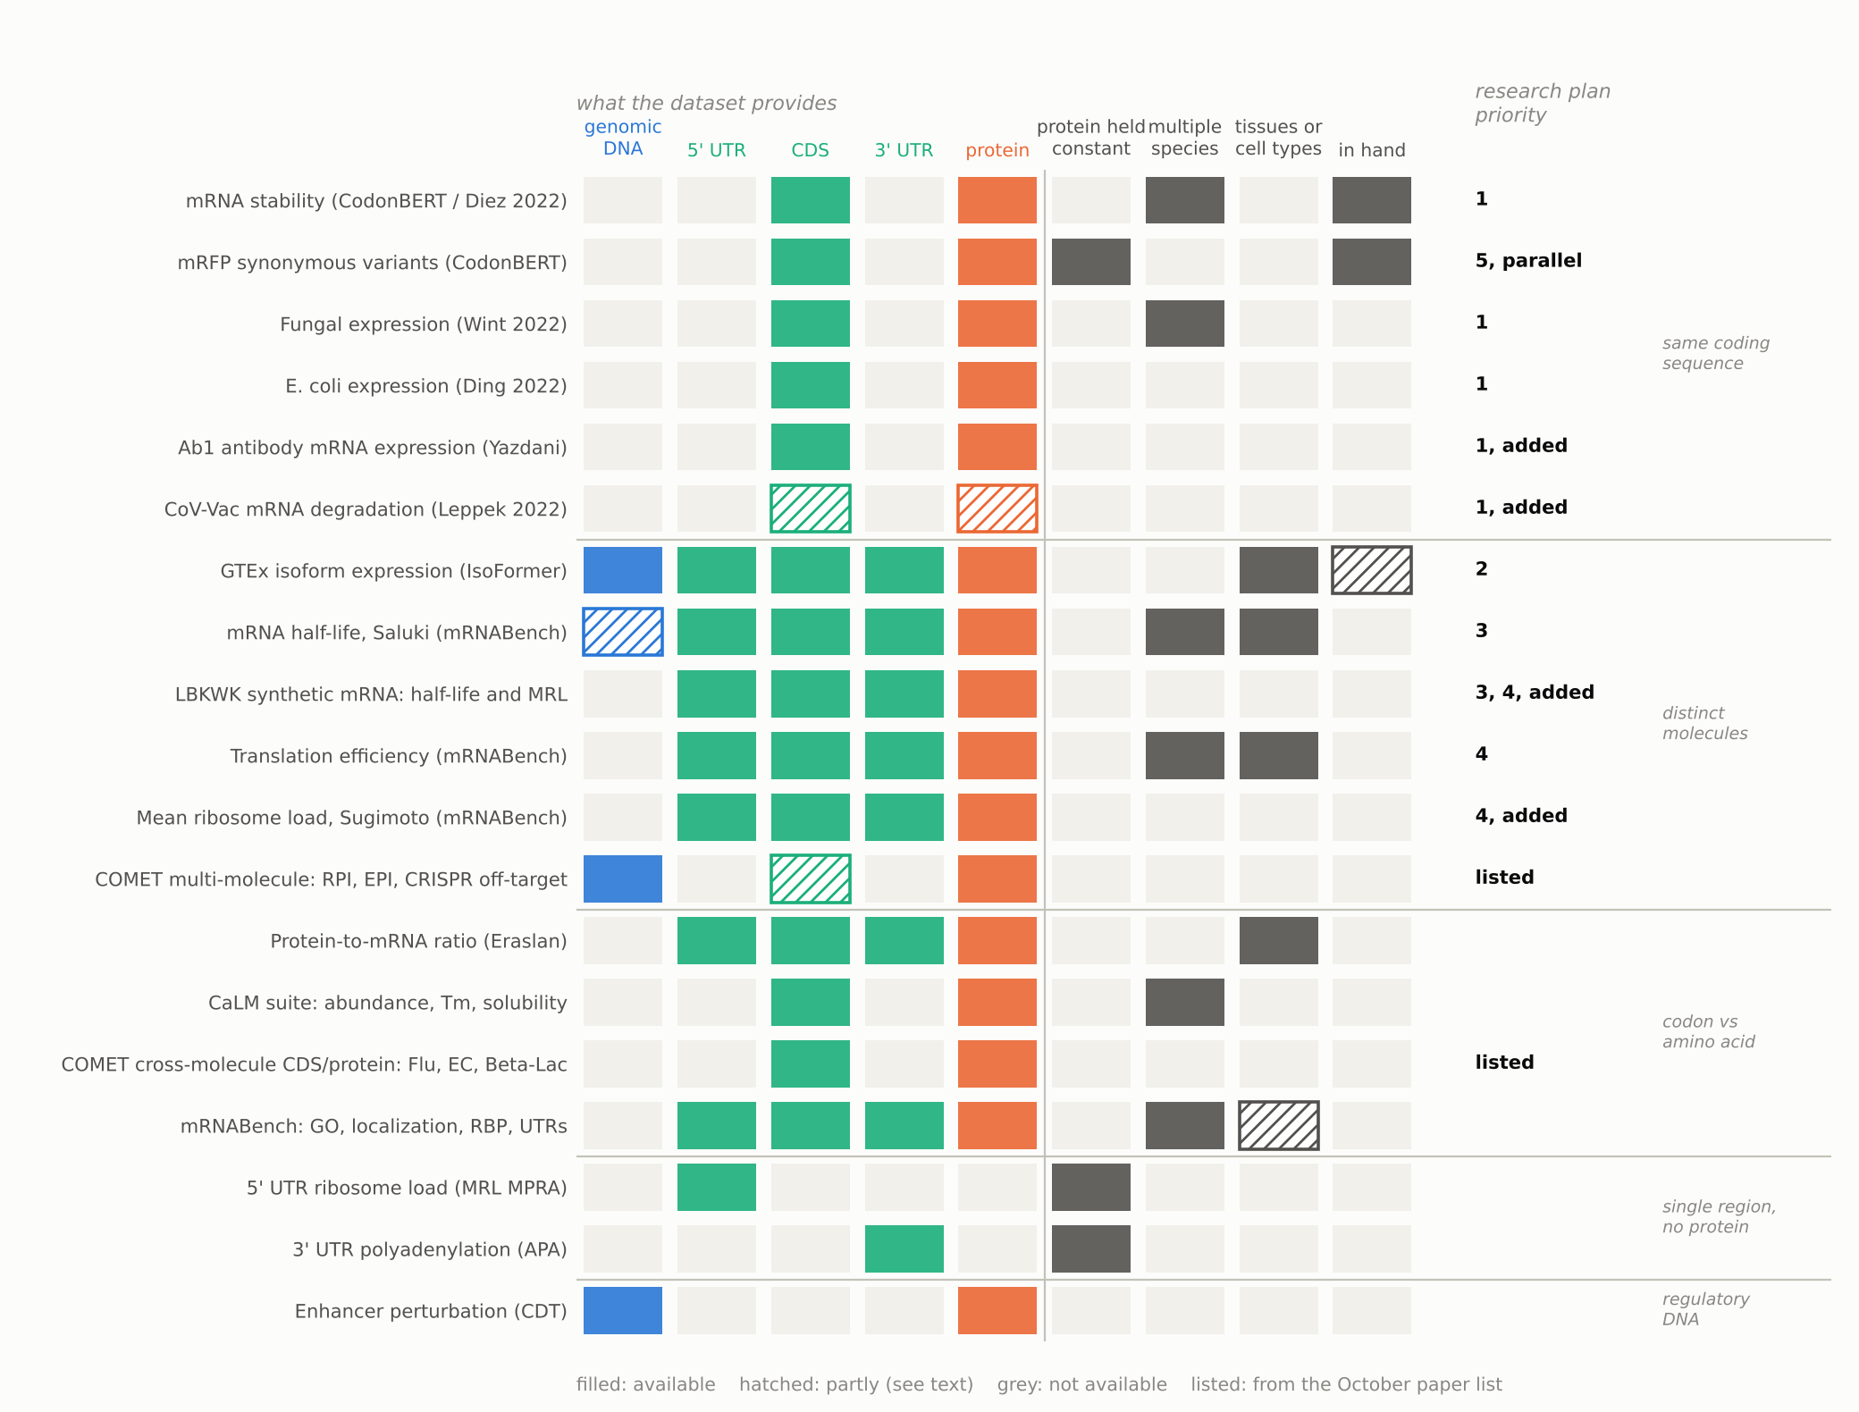
Each dataset isolates one question; the research plan adds five and marks its priorities
Stage 4 · datasets and tests
Same coding sequence to every encoder. Codon against amino-acid tokens; Ab1 and CoV-Vac added so the BioLangFusion reproduction covers all five benchmarks.
Distinct molecules and full transcripts. UTRs the codon encoders cannot read; CDS only against plus 3' UTR against the full transcript, plus protein. The mRNABench splits add gates on regions, labels, and grouped splits.
Labels kept distinct. Half-life (Saluki, LBKWK), translation efficiency (TE human, mouse), and ribosome load (Sugimoto, LBKWK MRL) each on their own split and metric.
From the October papers: COMET's multi-molecule tasks (RNA-protein, enhancer-promoter, CRISPR off-target) already report LucaOne and pairs of single-omics models, so "which encoder with which for which task" has published reference points there.
Reference points: Saluki r 0.77 with codon and exon-junction tracks; RiboNN 5' UTR about 22%, CDS about 73%, 3' UTR about 5%; LucaOne's 1,280-token limit truncates most stability coding sequences and the whole GTEx window.
Notes:
The matrix is the Stage 4 task set, grouped by the question each dataset answers, with the research plan's priority in the right column and the five datasets it added marked. The coding-sequence group at the top is where the codon grid applies, and Ab1 and CoV-Vac join it so the BioLangFusion reproduction covers all five benchmarks. The full-transcript sets are where the untranslated regions matter and the codon encoders cannot read part of the input, so the coding-sequence streams go on the grid and the UTRs are handled separately. One thing the plan is strict about and we have adopted: half-life, translation efficiency, and ribosome load are three different targets and are never relabeled as each other. The order of work is the one we had, with the added files folded in. COMET, from Mina's list, is the one new source that matters most here: its multi-molecule tasks already compare LucaOne with pairs of single-omics models, which is exactly the combination question, so our fusion designs get published numbers to beat on those tasks.

Slide 17
Compact students that copy their teachers' similarity structure, then fused: what Stage 1 already says
Stage 4 add-on · multi-teacher distillation, to think about
The idea
What Track B and Track A say
RNA teacher 1
The loss distills exactly what we measured. A teacher's similarity matrix is its RSA structure; for every pair with a DNA encoder, 52% to 90% of that structure is letter, codon, and amino-acid composition. A DNA student trained on raw similarities would mostly learn counts. Raw or composition-controlled target is the first decision.
B × B cosine similarity matrix per teacher
student + one projection per teacher
RNA teacher 2
→
≈
... teacher K
One student per modality (six DNA, five RNA, four protein teachers). Loss: mean squared difference between the teacher's and the projected student's off-diagonal similarities, averaged over teachers with equal weights. Teachers frozen; relational distillation (Park 2019) with teacher-specific heads.
Teachers are not all distinct. RNA-FM and RiNALMo agree at CKA 0.81; the ESM-2 family is near-redundant. Equal weights count a redundant structure twice.
Then freeze the students, concatenate, train a task head. Report Δstudent (over the best student) and Δteacher (against full teacher fusion), with parameters, memory, and inference cost. Neither is a training loss.
Sequence-level loses the codon signal. The codon encoders' contribution lives in local detail (GC3 at R² 0.90 to 0.99 against 0.38 to 0.44 for protein encoders); a region- or token-level term would be needed to keep it.
Notes:
This is the exploratory idea at the end of the plan, and the ask was to think about it, not build it. The mechanism: each frozen teacher gives a batch-by-batch similarity matrix between sequences, and a small student with one projection per teacher learns to reproduce those matrices; then the three students are frozen and fused. Our Stage 1 measurements are directly about those similarity matrices, so we can already say three things. Most of what a DNA teacher's matrix contains is composition, so the target should probably be the composition-controlled structure, or the student will learn to count. Several teachers carry the same structure, so equal weights double-count them. And a sequence-level loss cannot keep the codon-level detail that made the codon encoders useful in the first place. The natural place to evaluate it is on the five BioLangFusion sets with the reproduced heads, so the deltas line up with Phase B.

Slide 18

What we build first, and what we need from you
Stages 3 and 4 · order of work and questions
The Gantt chart with the add-ons folded in
Questions for Mina
Harden baselines (Gantt 16) and reproduce BioLangFusion on all five published datasets, deviations recorded (17, widened); mRFP in the controls (18)
Coupled Mamba feasibility (20) in parallel, then evaluated against the reproduced heads on identical splits (21)
Encoder swaps in the reproduced pipeline (24, now planned), and the alignment-loss ablation (23); LucaOne frozen baseline beside 16 and 17
Cross-attention on GTEx (25, conditional); repeated runs and uncertainty (28); synthesis (29)
mRNABench half-life and translation efficiency after the gates (38, or earlier if time allows); structure features conditional
Is "agreement on what the central dogma shares, beyond composition" the representational-alignment framing for the paper, with the codon grid named as a token-location step?
No official BioLangFusion code: is a reimplementation with documented deviations (TextCNN sizes, projections, seeds) acceptable as the faithful baseline?
Where the add-ons sit in the Gantt chart: widen ID 17 to the five published datasets, make ID 24 (swaps) planned and move it ahead of ID 23, add a LucaOne row, put mRNABench in ID 38 unless time allows earlier. Does that order work?
LucaOne's 1,280-token limit: run truncated inputs with truncation reported, or restrict to sequences that fit?
Distillation: which encoders are the 6, 5, and 4 teachers, and should students match the raw or the composition-controlled similarity?
Notes:
The left column is our Gantt chart with the research plan's add-ons folded into the existing IDs; Coupled Mamba keeps its slot. The right column is where your answer changes what we build. The first is the framing question for the paper. The second matters before any training: we could not verify an official code release, so Phase A is a reimplementation from the paper, and we want to agree on which unreported details to fix and flag. The third is the Gantt question: we are proposing to fold the add-ons into the existing IDs rather than reorder the plan, and we want to agree the placement before the dates move. The fourth is the LucaOne truncation policy, which decides what its comparison means on long sequences. The fifth is the distillation idea: we need to know which encoders count as teachers, and whether the students should reproduce the raw similarity structure or the one left after composition is removed.

